Slide 1
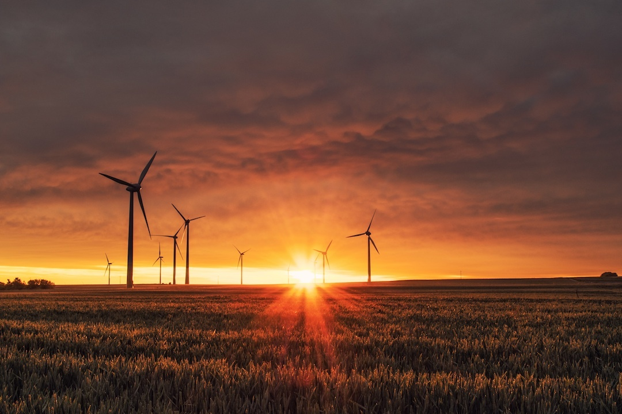
Natural Gas in the Global and Australian Energy Transition
18 May 2021
Bill Hare
Director, Climate Analytics
Adjunct Professor, Murdoch University
Jasmin Cantzler, Paola Yanguas-Parra

Slide 2
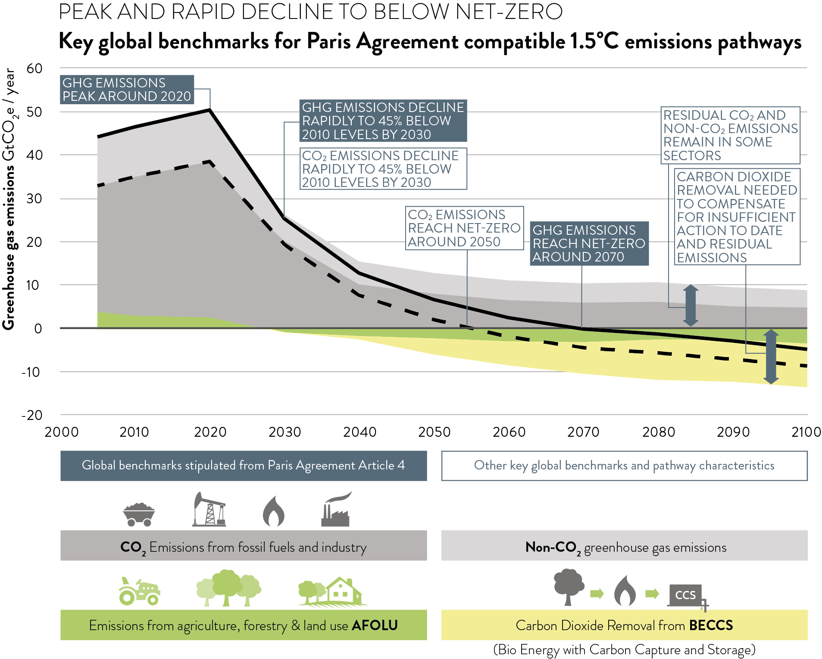

Paris Agreement 1.5ºC limit and emission goals
  Article 4

Slide 3
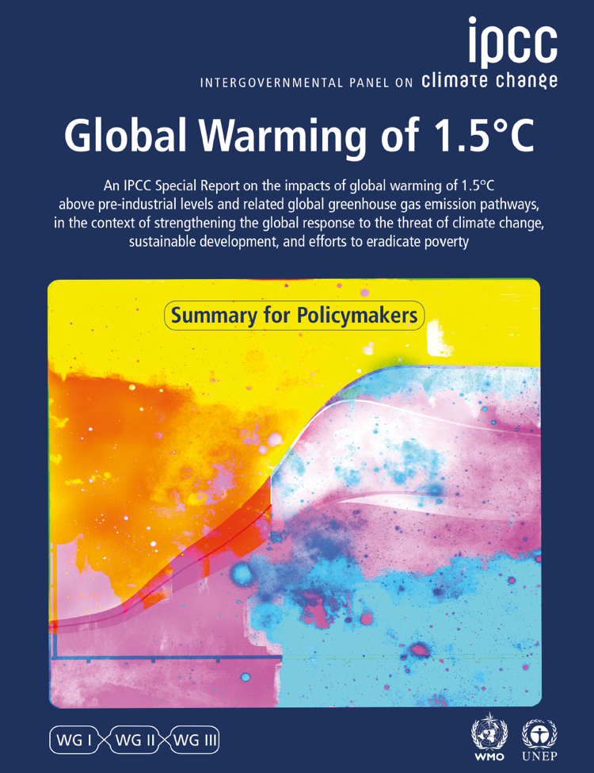

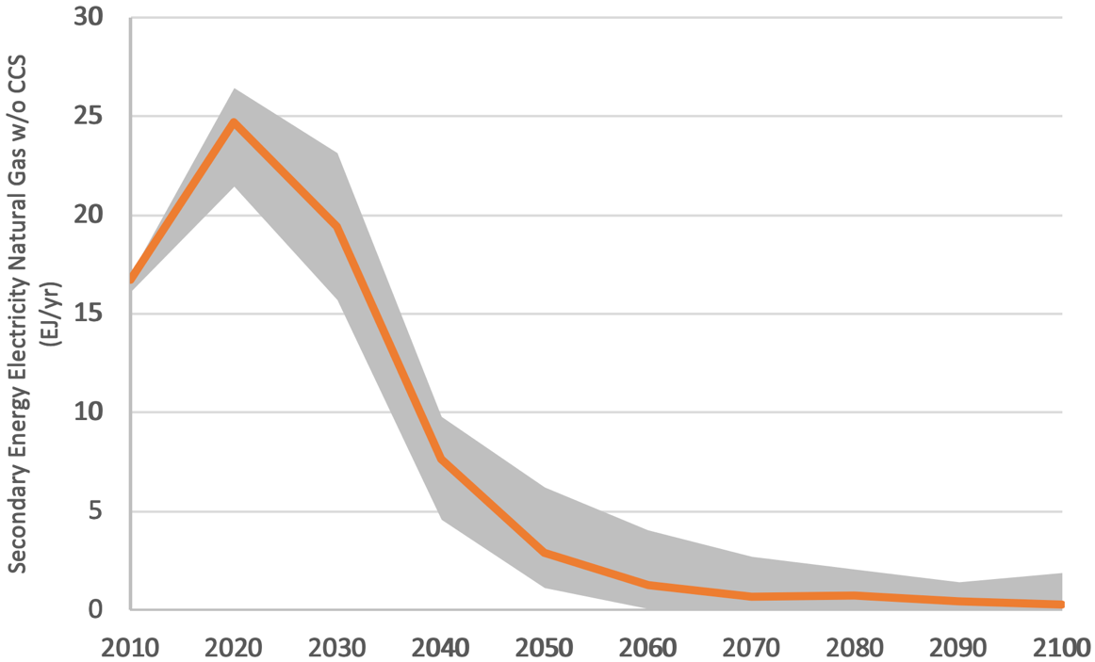
Very limited future for gas in a 1.5°C world
Rapid near-term reductions in all fossil-fuels is necessary to achieve the goals of the Paris Agreement
Even with CCS the role of natural gas in the power sector would be limited to 8% by 2050
It is unlikely there is a role for gas with carbon capture and storage (CCS): not competitive with RE and storage costs falling
Reducing energy demand and fast expansion of renewable energy: large benefits for sustainable development goals
IEA Sustainable Development Scenario projections for natural gas are at odds with IPCC 1.5°C Report findings
Gas in the Electricity Sector under IPCC vs. IEA SDS scenarios
Fuel | Change compared to 2010
 | 2030 (SR1.5) | 2030 (WEO SDS) | 2040 (SR1.5) | 2040 (WEO)
Natural gas | 14% [-10%, 37%] | 46% | -53% [-67%, -41%] | 12%
Natural gas (w/o CCS) in power sector is phased down rapidly

Slide 4
1.5C Scenarios see drastic reductions in gas generation
Coal power generation must:
Peak by 2020 and,
Rapidly decrease to 80% below 2010 levels by 2030 and,
Be phased out by 2040 at the latest
Unabated gas lags only slightly behind:
Peak by 2020 and,
Rapidly decrease to 80% below 2010 levels in 2040s and,
Be phased out in 2050s
Unabated coal & gas in power generation in 1.5C low and no-overshoot scenarios (SR15, interquartile range)

Slide 5
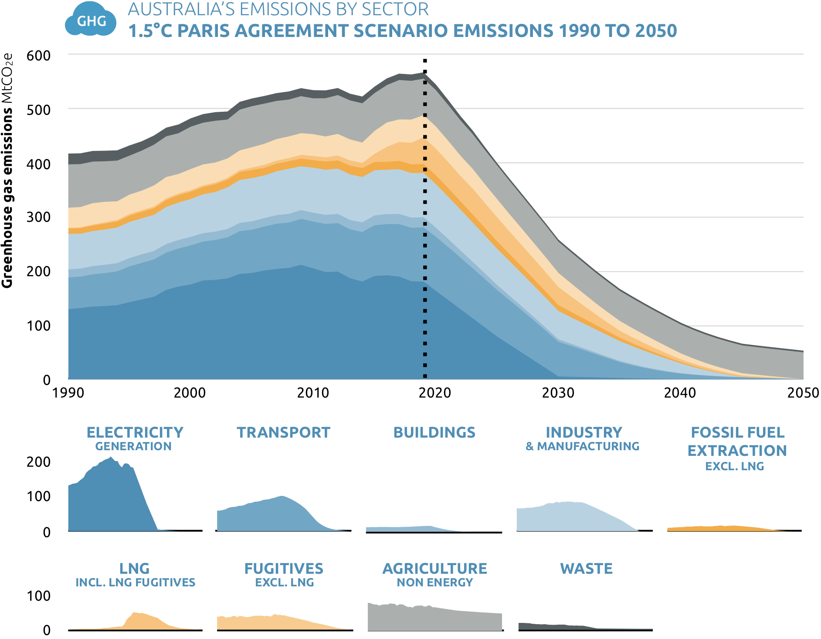

An Australian 1.5ºC compatible GHG pathway
Accelerated climate action in line with Paris Agreement-compatible scenarios needed across all sectors.
By 2030
50% below 2005 excluding LULUCF.
66% below 2005 by 2030 including LULUCF
Net-zero
by 2050 with end of deforestation by 2030 + forest carbon storage
by 2040 with doubled forest carbon storage
Notes:
ustralia’s Paris Agreement-compatible greenhouse gas emissions pathway (not including LULUCF)

Slide 6
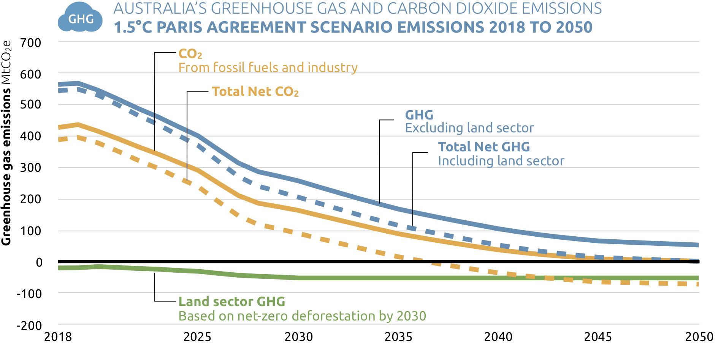
An Australian 1.5ºC compatible GHG pathway to net-zero
All GHG Net-zero by 2050
Net zero by 2040 if deforestation ends by 2030 and forest carbon storage doubles by 2040

Slide 7
Natural Gas use in Reference Scenario

Slide 8
Natural Gas use in Paris Agreement Scenario

Slide 9
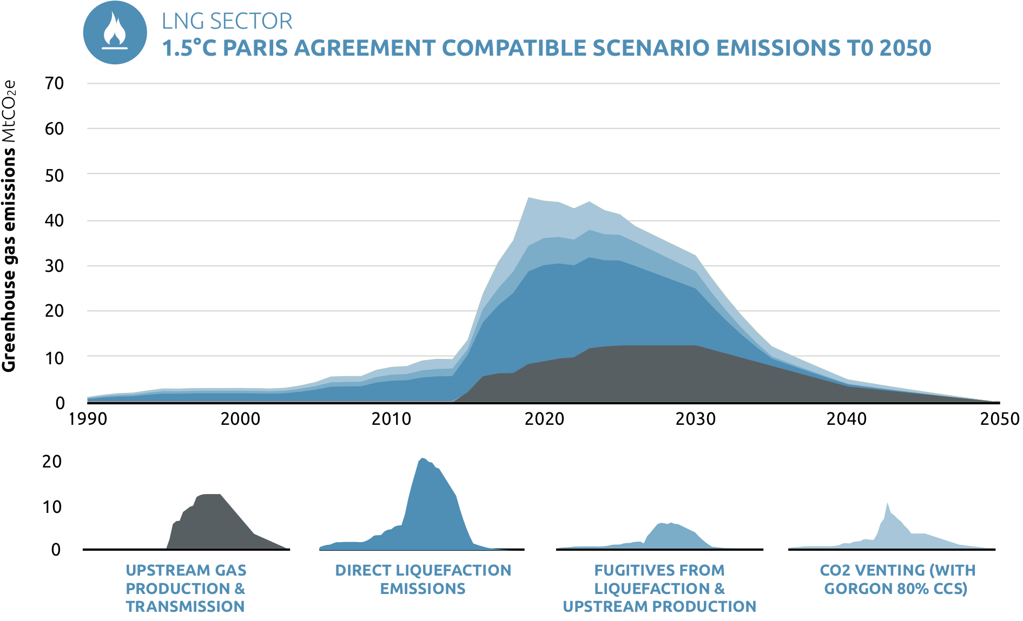
LNG sector: contributions to abatement

Slide 10
IEA: Renewables are on track to set new records in 2021

Slide 11
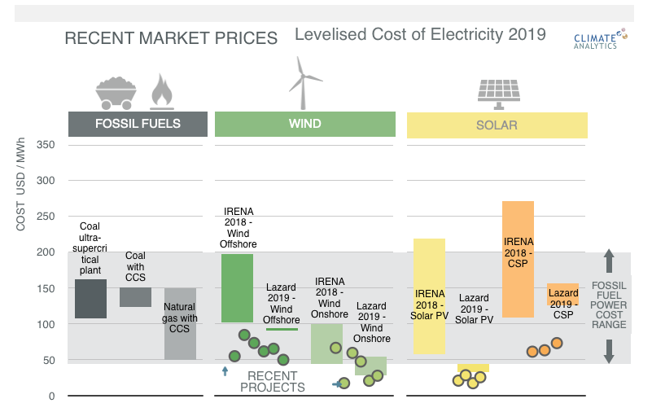
Way forward: Large potential to speed up action in the power sector
Renewable energy technologies are cost-competitive with new fossil fuel plants and large parts of the operating fleet in many places
Levelised Cost of Electricity of different generation technologies in 2019. Source: Own elaboration based on Lazard analysis (LAZARD, 2019) and IRENA (IRENA, 2020).

Slide 12
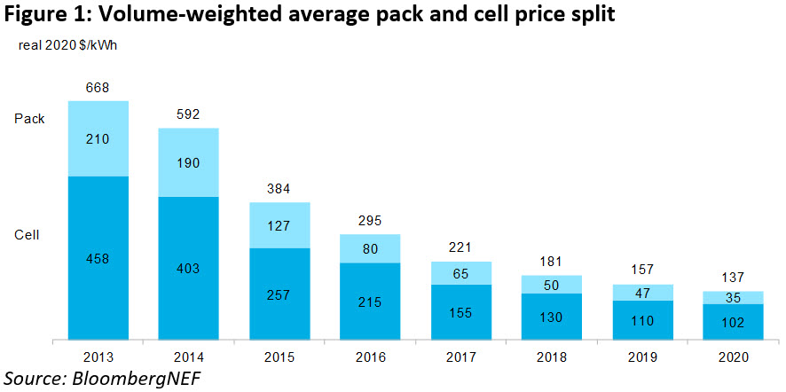
More stunning falls in solar and battery storage costs
https://about.bnef.com/blog/battery-pack-prices-cited-below-100-kwh-for-the-first-time-in-2020-while-market-average-sits-at-137-kwh/

Slide 13
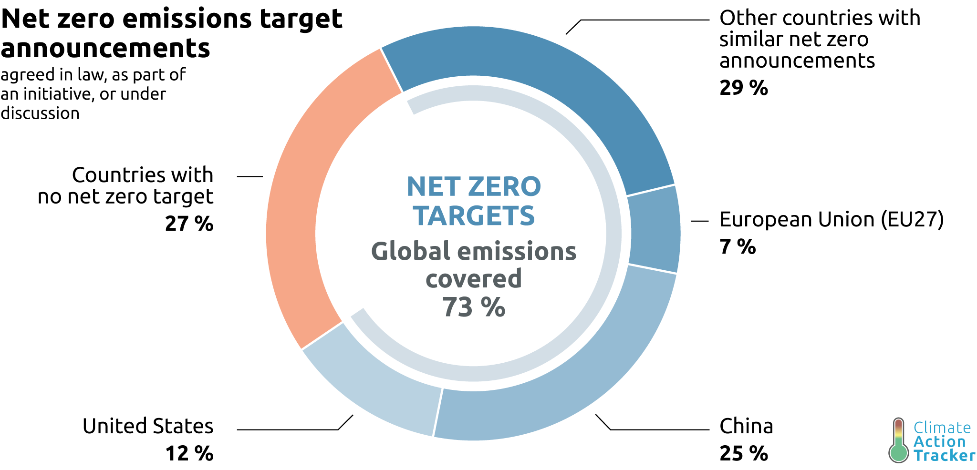
Net Zero Goals and Australia’s Markets for LNG and Coal
Will affect major markets for Australian fossil fuels
2019-20 | Total Exports Million $ | Japan, China, South Korea | %
LNG | $ 47,617 | $ 41,465 | 87%
Metallurgical coal | $ 34,603 | $ 19,146 | 55%
Thermal coal | $ 20,382 | $ 15,129 | 74%
Total LNG + Coal | $ 102,602 | $ 75,740 | 74%

Slide 14
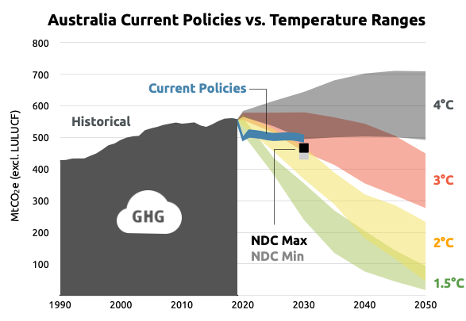
Australia: NDCs and policies are far from sufficient
Govt has:
No intention of updating 2030 target
Avoided adopting a net zero target
Rejects post 2020 renewable energy targets
No meaningful climate policies
Promoted a “gas-led recovery” from COVID-19 crisis will lock-in emissions over the long-term
Promoted new funding for CCS projects
Domestic emissions pathways presented here are not final and are likely to change when we present the final results.

Slide 15
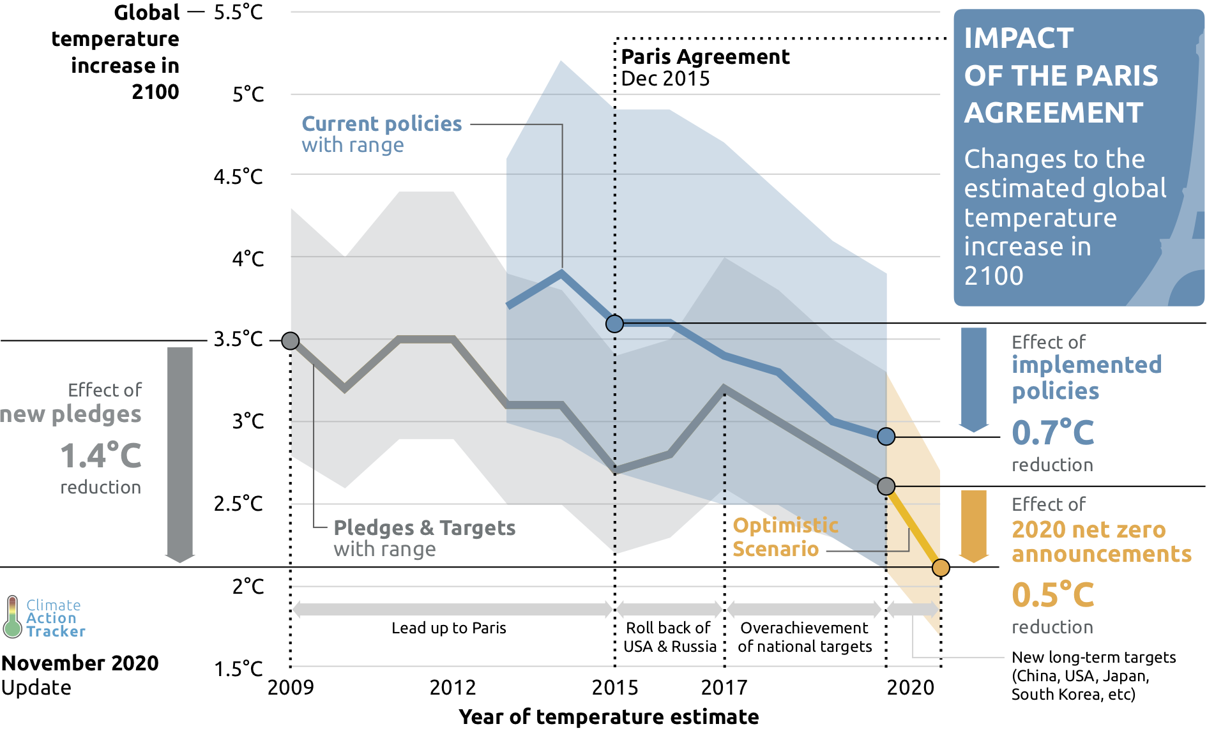
Paris is driving action, but….

Slide 16

Thank you!

Slide 17
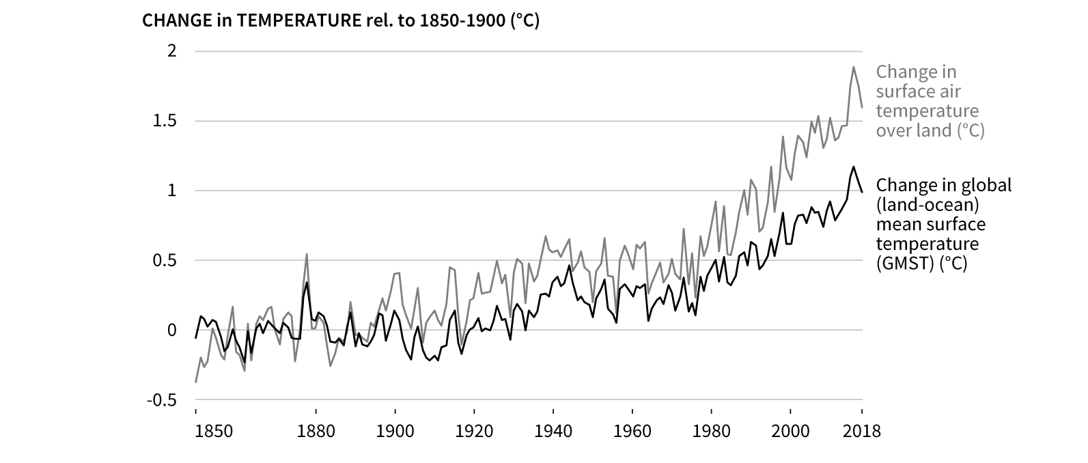
Land temperatures have already passed 1.5C
IPCC Special Report on Climate Change and Land

Slide 18
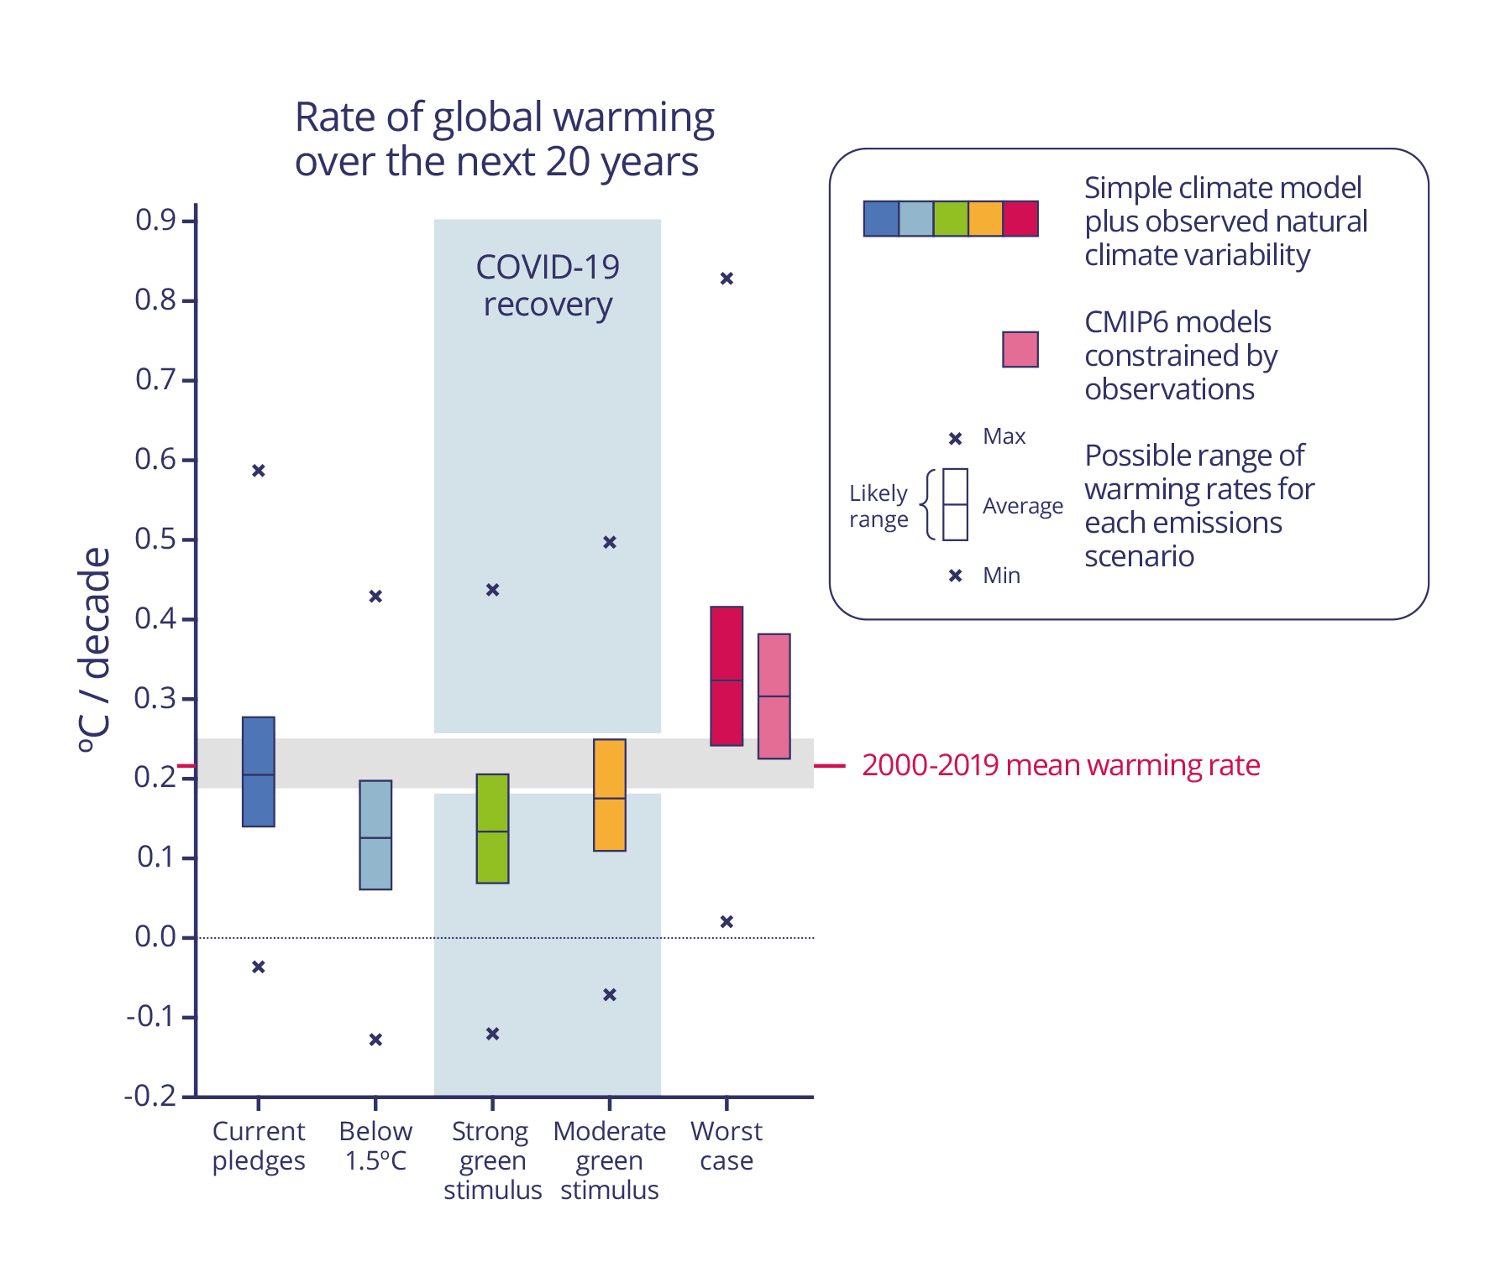
We can limit warming to close to 1.5C over next decades if we act now
McKenna et al. Nat. Clim. Chang. 11, 126–131 (2021). https://doi.org/10.1038/s41558-020-00957-9

